Slide 1

Energy/Resource Concepts and Terms
resources: all materials in the environment that can be used.
reserves: quantities of resources that are known and are legally and economically extractable with current technology.
projected reserves: current reserves plus all resources that may become reserves due to improved technologies and changing prices.
renewable resources: such as farmland soil, water, solar, forests, and fisheries, where the sustainable rate of use can be no greater than the rate of regeneration.
solar-based renewable energy resources are ultimately powered by the sun: solar, wind, hydropower, wave and biomass

Slide 2

Resources (con’t.)
non-renewable resources: substances such as fossil fuels, high grade mineral ore, and fossil groundwater. Can these have a sustainable rate of use?
  one view: their sustainable rate of use can be no greater than the rate at which a renewable resource can be substituted for it (eg. oil, where part of the profits are invested towards the development of renewable resources, so that renewables can eventually substitute for oil)

Slide 3
Energy externality: any cost to parties outside of a business transaction that is not borne by buyers or sellers - eg pollution, health (controversial)

Slide 4
Some Common Forms of Energy
Energy: the ability of a body or system to do work or produce a change
Kinetic energy: the energy of motion.
Gravitational potential energy: stored energy associated with an object/substance that's been lifted against Earth's gravity. Key form: water stored behind dams for hydroelectricity.
Elastic potential energy: stored energy as a result of changing the configuration of an elastic substance.
Chemical energy: electrical energy stored at the microscopic level in the configurations of electric charge known as molecules. Example: fossil fuels “store” electromagnetic energy from the sun. When combusted, the original energy in the bonds of the reactants = the heat energy released plus the chemical energy of the newly formed compounds (including carbon dioxide) .
Nuclear energy: energy released by changing the energy relations of the atomic nucleus, either by combining nuclei (fusion) or by splitting a nucleus into smaller nuclei (fission). Fusion powers the stars – such as the fusion of two hydrogen atoms to form helium (our sun). Fusion powers nuclear bombs.
Notes:
Fusion – in some massive stars, fusion makes heavier elements as well.

Slide 5
Thermodynamics
Internal or thermal energy: energy of molecular motion.
Heat: energy that is flowing as a result of a temperature difference.
First Law of Thermodynamics: In any process, energy can neither be created nor destroyed. The change in an object’s or substance’s internal energy is the sum of the mechanical work done on it and the heat flows into it. Examples: bicycle pump, Joule’s experiment (see next slide)

Slide 6
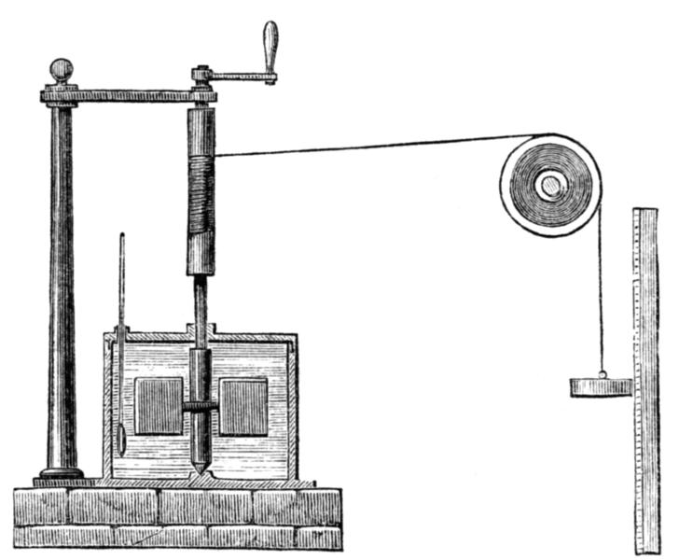
The James Joule experiments showing the equivalence of heat and mechanical energy
Thermometer was used to measure the change in the temperature of water that was being churned by a revolving vane driven by a descending weight.

Slide 7
Second Law of Thermodynamics: the entropy law. Entropy is the degree of disorder in a system. The energy of the universe is fixed and its distributions uneven, and thus its conversions seek uniform distribution. In a closed system (w/o external energy supply), the availability of useful energy must decline.
  example: burning a log. Its combustion produces heat. The log can never be reconstituted with only the amount of energy released. The heat released is a lower quality of energy.
  Is photosynthesis an exception to the Second Law?

Slide 8
The Carnot Cycle Principle: e = 1 - T_{c}/T_{h}
e = efficiency = mechanical energy delivered ÷
energy extracted from fuel
T_{c} = temperature (K) of the cool substance (ambient air)
T_{h} = hottest temperature (K) the heat engine can achieve
typical example temps of T_{c} = 300, T_{h} = 650 in a fossil-fueled steam plant
e = 0.52
most nuclear plants have a of T_{h} = 570, making an efficiency of 0.48
These are theoretical maximum efficiencies assuming no friction losses, energy delivered to pollution control systems, etc... discounting these losses, most large electric power plants are ~30% efficient.

Slide 9
Quality of energy
Primary energy: in an energy system, the total energy available at the source. In a natural gas combustion turbine that generates electricity, it’s the total chemical energy in the natural gas. In this example, combusting fuel produces low quality heat and higher quality energy in the form of mechanical energy and/or electricity.
Example of differing energy quality:
-2 ton car going 30 mph has ~200 kJ of kinetic energy
-1 tsp. of gasoline has ~200 kJ of combustible chemical energy. Combustion would produce random kinetic energy, but we would have to somehow get all those molecules moving in the same direction so they could impart all their energy to the car.
-the extra internal energy stored in a gallon of water when heated by 10°C is ~200 kJ. The extra energy in the water is random kinetic energy of individual water molecules.
Which of above has lowest entropy? (least randomness) highest?
The hierarchy of energies: heat is a lower quality form of energy than electricity or mechanical energy. Heat cannot be transformed as efficiently into electricity as electricity can be transformed into heat (nearly 100%).

Slide 10
Energy Quality
Energy quality can be measured along a hierarchy, from the highest quality and lowest entropy to lower quality and higher entropy
Ranked in quality from high to low:
  mechanical (potential and kinetic) and electrical (~same quality)
  chemical
  energy of objects/substances at high temperatures
  energy of objects/substances at low temperatures

Slide 11
Other misc energy basics
energy conversion: when one form of energy is transformed into another.
The efficiency of energy conversions can be measured as the ratio of energy in to useful energy out. Conversion from electrical to light energy can be >30% with LED technology but very low with standard incandescent bulbs (<10%). However conversion of electricity to heat can be 100% in baseboard heaters, to ~90% with incandescent light bulbs. However, the systemic energy conversion ratios in the previous examples are all substantially lower when considering the total primary energy supply. Why?
---------------------------
Solar thermal conversion to electricity:
http://www.scienceagogo.com/news/20080113172845data_trunc_sys.shtml
Solar photvoltaic conversion efficiency
http://www.gizmag.com/unsw-world-record-solar-energy-conversion/35098/
power: the rate of energy use, such as watts, horsepower, etc…
energy: power x time; a quantity of energy, such as a watt-second, kilowatt-hour, calorie (c), joule (J), etc. Example: a watt-second = one J
energy density: the ratio of energy supplied or utilized per unit area. Most common is watts per square meter. Example, Smil p. 165. Related concept is power density. (see graph in class folder)

